Slide 1


Slide 2
Planning for unreliable robots(Lewis and O’Kane 2013)
Presented for Prof. Becker’s Robotic Swarm Control Lab by Daniel Bao
6/7/17
Most pictures/diagrams are from this article.
2

Slide 3
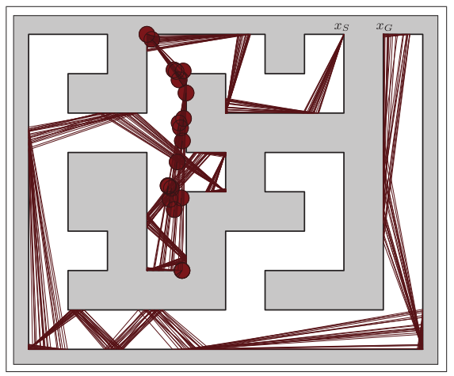
Abstract Abstract
How to get from Xs to Xg
Unreliable Robot

Slide 4
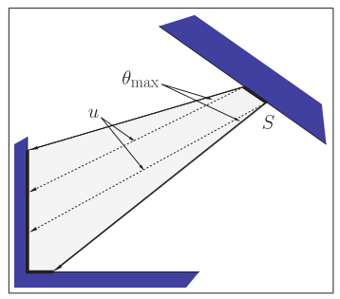
Problem Solving Approach
Error Cones
Safe Moves!

Slide 5
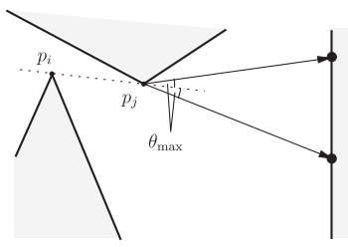
Problem Solving Approach
Delimiting Points

Slide 6
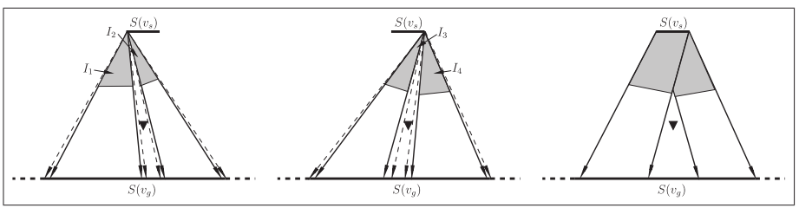
Algorithms
Edge generators

Slide 7
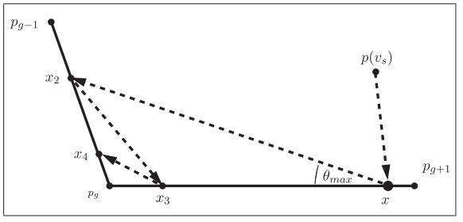
Algorithms
CornerFinder

Slide 8
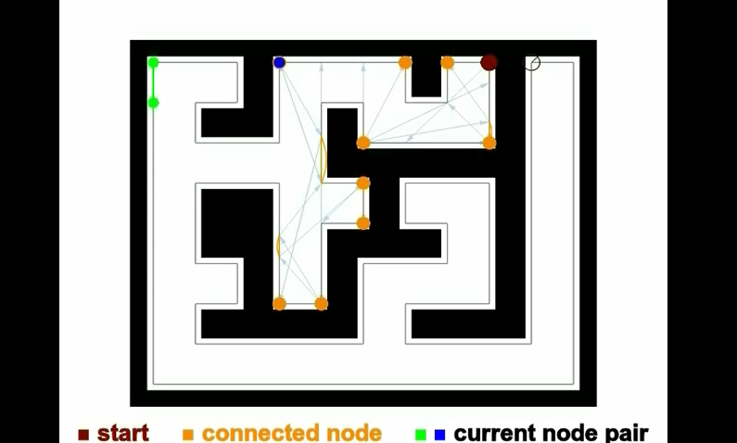
Algorithms
NodeConnector
Prioritized on point nodes
Closer distance to goal

Slide 9
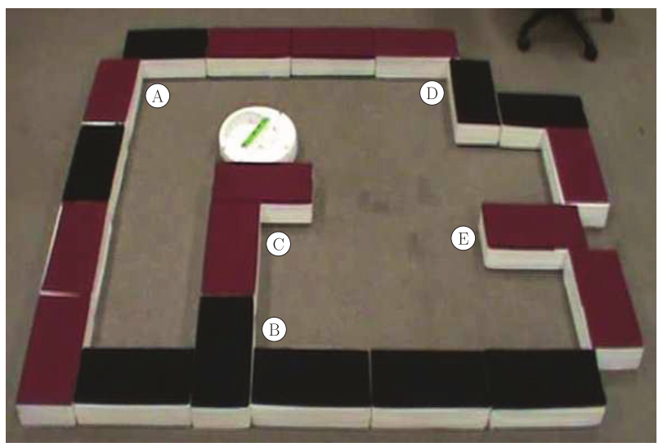
Implementation
The algorithm works!

Slide 10
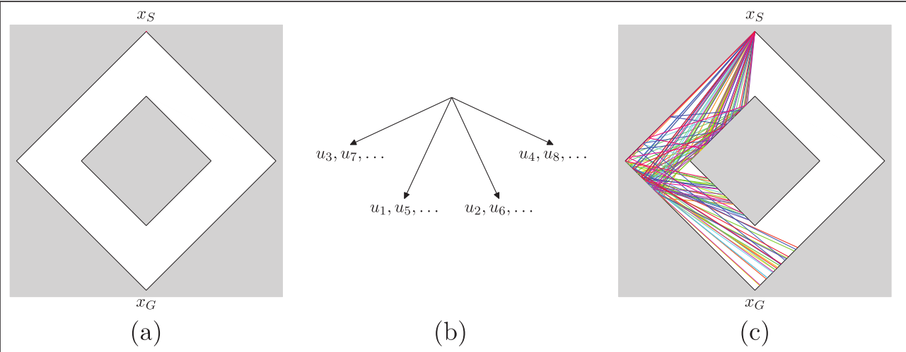
Limitations

Slide 11
Relations to my Research
Global Swarm Convergence
Corner movement/localization

Slide 12
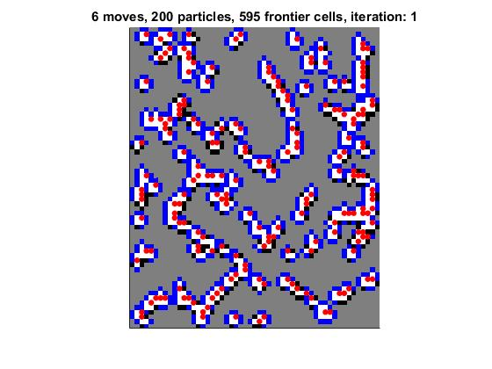
Relations to my Research
Particle Mapping
Simple robots
Planned actions

Slide 13
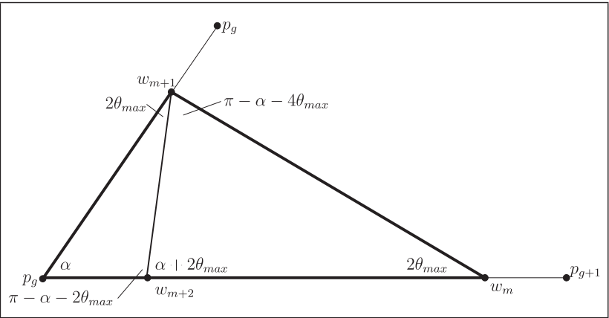
Answers to Quiz!
Translational Motion, Bump Contact Sensor, Noisy Compass, Angular Error
Minimalist approaches make this technology more practical
Point node is degenerate, at convex/corner
Segment node is everything else
See this image
It uses oscillating motion to generate edges
Safe actions allow the robot to get to one edge of W
It chose an unsafe action!

Slide 14
Works Cited
Lewis, J. S., & O’Kane, J. M. (2013). Planning for provably reliable navigation using an unreliable, nearly sensorless robot. The International Journal of Robotics Research, 32(11), 1342–1357. https://doi.org/10.1177/0278364913488428

